Slide 1
FINALLY!
Running Records for
Math Interventions
Beatrice Holmes & SeTia Freeman
@bea_holmes1 @FreesEdWorld
October 17, 2019

Slide 2
Who’s here today?

Slide 3
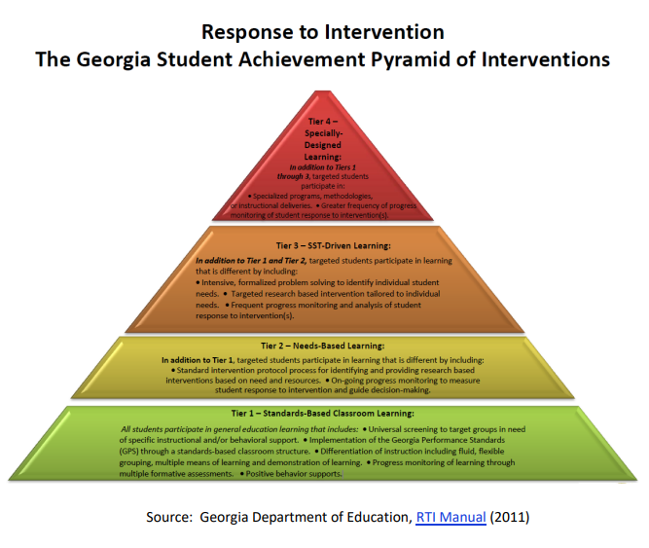

Slide 4
LET’S WORK TOGETHER!
Ask a neighbor:
What are your top 3 needs to have effective math interventions?
Make a list using a marker and a sticky note.

Slide 6
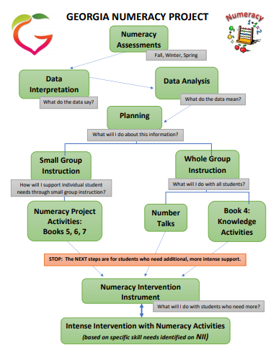
GEORGIA NUMERACY PROJECT

Slide 7
GEORGIA NUMERACY PROJECT

Slide 8
Identify students who are “Cause for Concern” or “At Risk”
Provide targeted intervention support via small/individual support
Analyze individual student performance to determine next steps

Slide 9
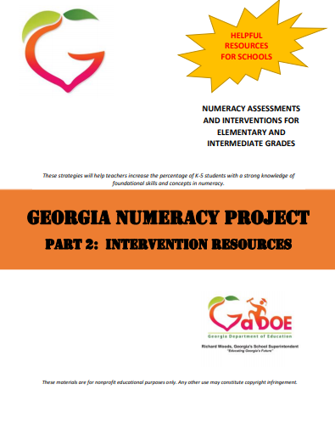
Progress Monitoring Tools to:
Identify students who are “Cause for Concern” or “At Risk”
Strategic lessons to:
Provide targeted intervention support via small/individual support
Data Collection Tools to:
Analyze individual student performance to determine next steps

Slide 10
Begin with the end in mind!
What are the end-of-year expectations?

Slide 11
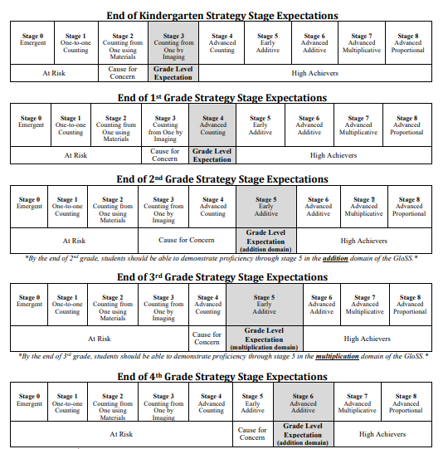
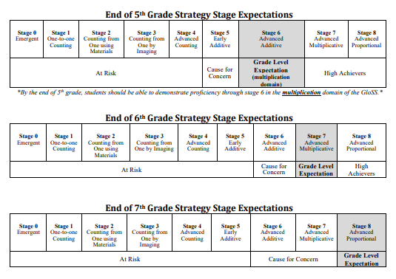
GloSS: Global Strategy Stage

Slide 12
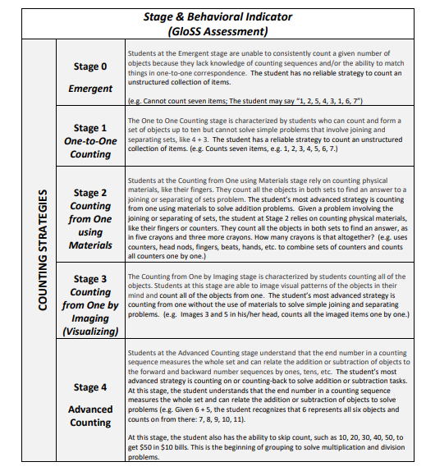
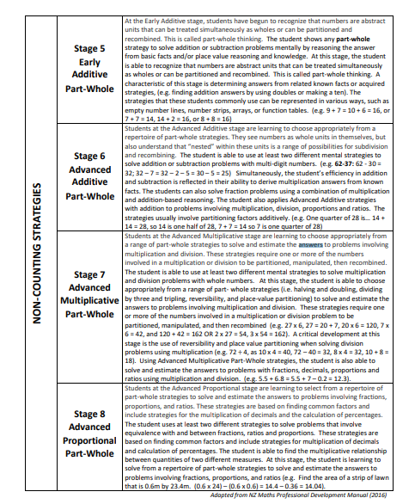

Slide 13
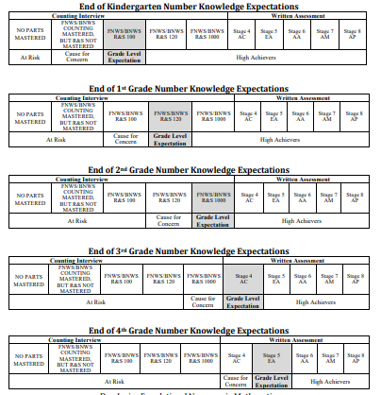
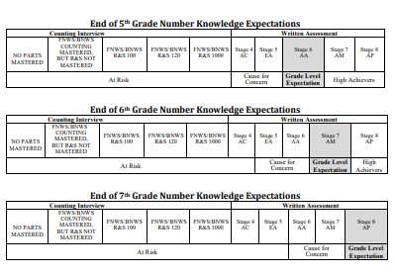
IKAN:
Individual Knowledge Assessment of Number

Slide 14
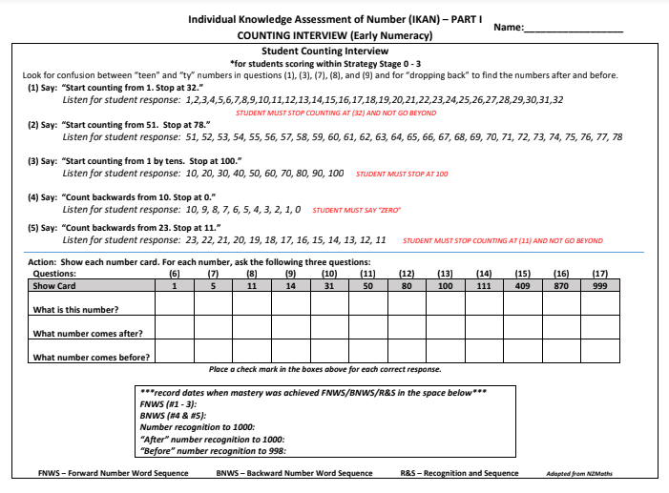
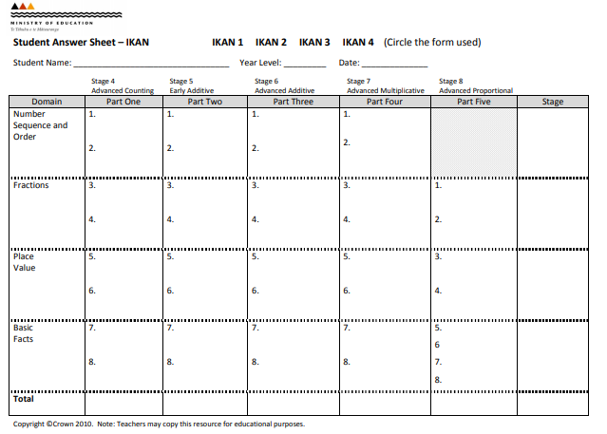

Slide 15
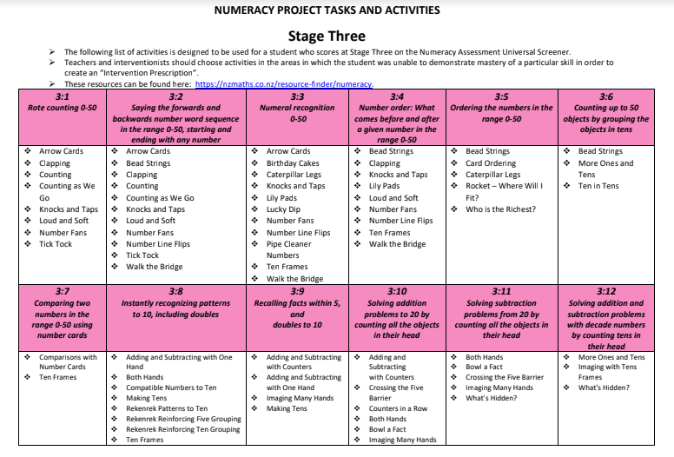

Slide 16
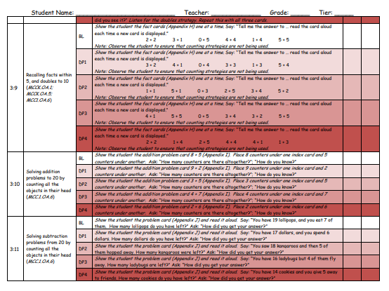
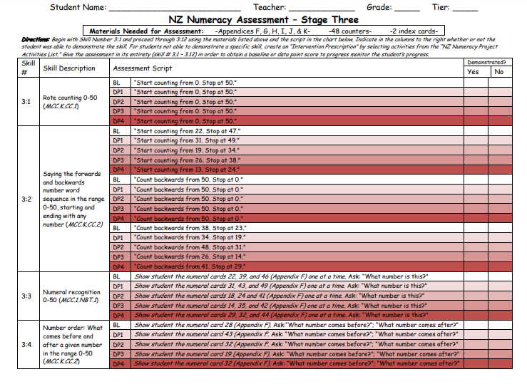
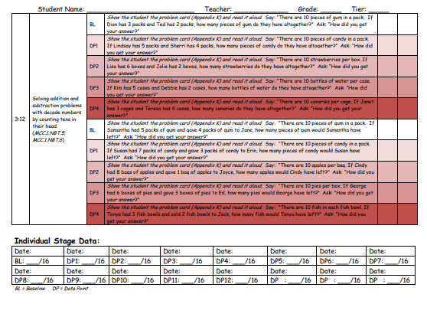
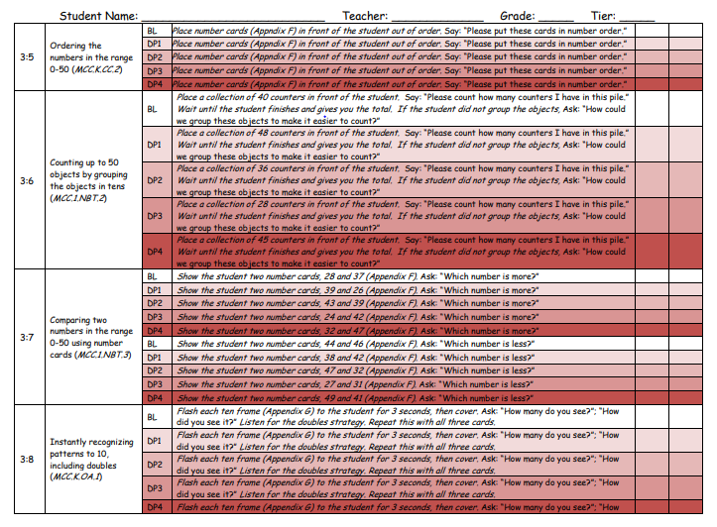
Baseline questions
Materials needed
Domains mastered
Data points
Skills
Individual stage or cumulative data

Slide 17
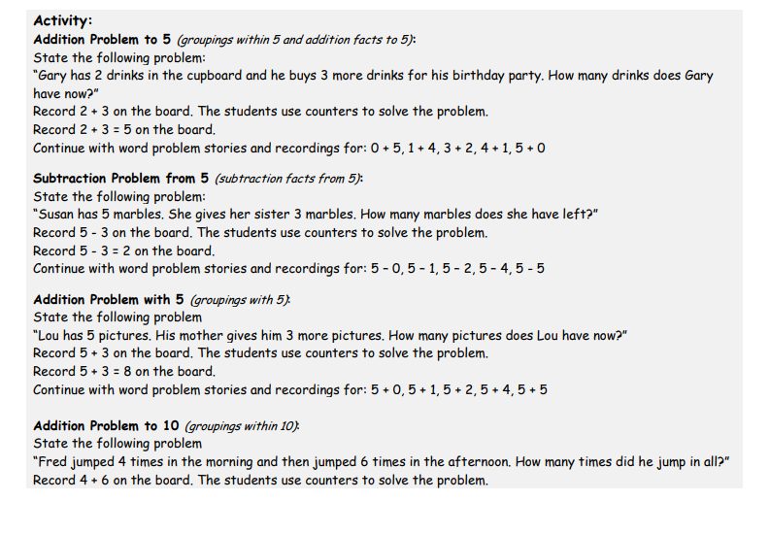
Strategic Lesson Plan

Slide 18
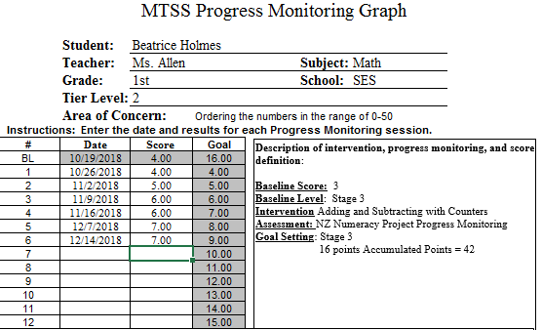
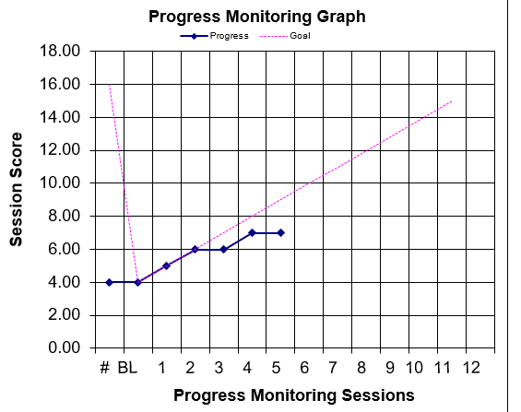
Analyze Your Data for Next Steps

Slide 19
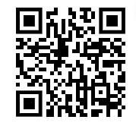
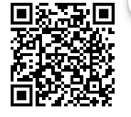
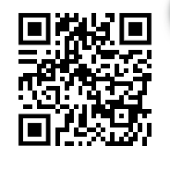
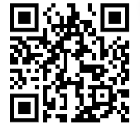
Ms. Holmes
Teacher Resources
GA
Numeracy Project
Material Masters
NZ Resource Guide

Slide 20
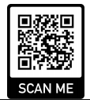
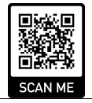
Thank you for your participation!
Can we have feedback, please!
@ Bea_holmes1 @freesedworld
C Conference Session

